Slide 1
COMPANIES DATA ANALYTICS
By Jenish Bhanawat

Slide 2
Overview
The objective of this presentation is to provide a comprehensive analysis of companies based on various attributes using Power BI Dashboard.
Data Description:
The dataset comprises information about multiple companies including
their valuation, date joined, industry, location, year founded, funding, and
selected investors
Columns:
Company Name, Valuation, Date Joined, Industry, City, Country,
Continent, Year Founded, Funding, Selected Investors.

Slide 3

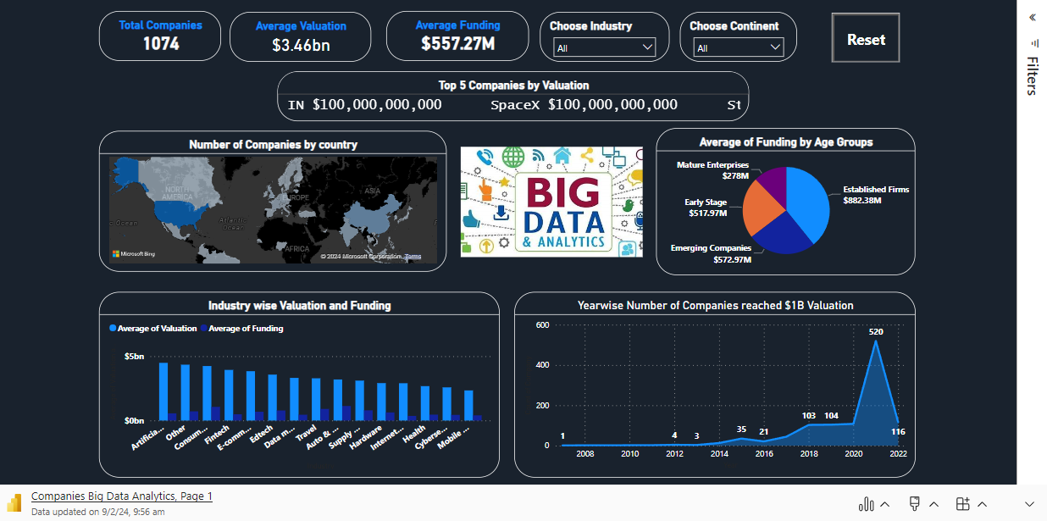
Live Dashboard

Slide 4
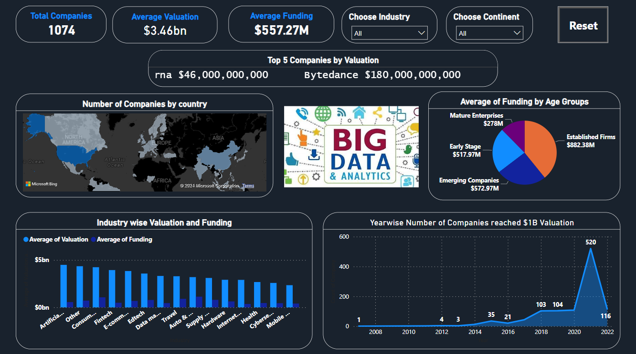
Dashboard Image

Slide 5
Data Cleaning Process
Null Values Handling:
Addressed missing values in the 'City' column by replacing them with the most frequent city.
Company Identification:
Identified and distinguished companies with similar names to ensure accurate analysis. For instance, 'Bolt' and 'Bolt 2'.
New Attribute Creation:
Introduced 'Age' and 'Age Group' columns to better understand the maturity level of companies based on their founding years.
The classification of Age Group is like this: Early Stage (0-10 Years Old), Emerging Companies (11-20 Years Old), Established Firms (21-40 Years Old), Mature Enterprises (More than 41 Years Old).

Slide 6
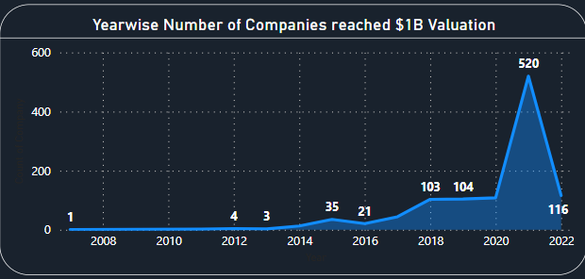
Year Wise Number of Companies reached $1B Valuation
The area chart illustrates the trend in the number of companies reaching a one billion dollar valuation over the years.
Notable observations from the chart:
In 2018, there were 103 companies reaching the billion-dollar valuation mark.
The following year, 2019, saw a slight increase with 104 companies achieving this milestone.
The trend continued upward in 2020, reaching 108 companies.
However, the most significant surge occurred in 2021, skyrocketing to 520 companies, marking a substantial increase compared to previous years.
Surprisingly, in 2022, there was a dramatic decline, dropping back to 116 companies.

Slide 7
Possible Reasons
2021 Peak:
Investor Confidence: Heightened by favorable market conditions and increased venture capital investment.
Pandemic Response: Accelerated digital transformation led to rapid growth of technology-driven companies.
2022 Decline:
Market Correction: Adjusting inflated valuations to align with actual performance.
Economic Uncertainty: Global disruptions and regulatory changes influenced cautious investment strategies.

Slide 8
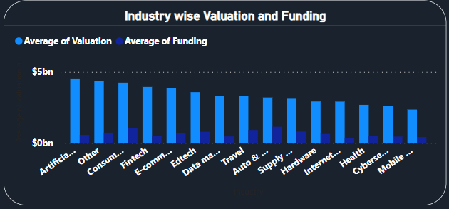
Industry wise Valuation and Funding
Highest Average Valuation:
Industries such as Artificial Intelligence, Other, and Consumer Retail exhibit the highest average valuations.
Lowest Average Valuation:
Sectors like Mobile and Telecommunications, and Cybersecurity demonstrate the lowest average valuations.
Valuation and Funding Proportional:
Companies with higher valuations tend to attract more funding, indicating a direct proportional relationship between valuation and funding.

Slide 9
Possible reasons
Innovative Technologies:
Industries like Artificial Intelligence and Consumer Retail often pioneer innovative technologies, capturing investor interest and driving higher valuations.
Market Demand:
Sectors like Mobile and Telecommunications may face intense competition and market saturation, resulting in relatively lower valuations despite substantial funding needs.

Slide 10
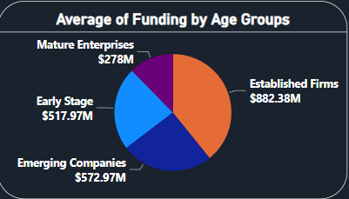
Average Funding of Companies by Age Groups
Established Firms (21-40 Years Old):
Highest average funding of $882 million.
Emerging Companies (11-20 Years Old):
Average funding of $572 million.
Early Stage (0-10 Years Old):
Average funding of $518 million.
Mature Enterprises (More than 41 Years Old):
Lowest average funding of $278 million.

Slide 11
Possible Reasons
Established Firms:
Access to Established Markets: Mature companies have established market presence and may attract higher funding for expansion and innovation.
Emerging Companies:
Growth Potential: Investors recognize the growth potential of emerging companies and are willing to invest substantial funds for scaling operations and market penetration.
Early Stage:
Innovation and Disruption: Early-stage companies often introduce innovative solutions and disrupt traditional markets, attracting funding for research, development, and market expansion.
Mature Enterprises:
Stability Over Growth: Mature enterprises may prioritize stability over growth, resulting in lower funding requirements for sustaining existing operations rather than aggressive expansion.

Slide 12
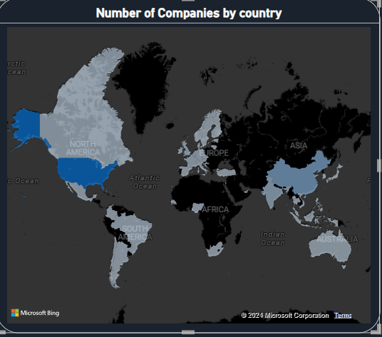
Number of Companies by Country
Highest Number of Companies:
USA: 562 companies
China: 173 companies
India: 65 companies
Lowest Number of Companies:
Countries like Bermuda, Bahamas, and several others have only 1 company each.

Slide 13
Possible Reasons
Economic Powerhouses:
USA, China, and India are recognized as economic powerhouses with thriving business ecosystems, attracting a large number of companies due to market opportunities, infrastructure, and investor confidence.
Business Environment:
Countries with only a single company may have smaller economies, less developed infrastructure, or regulatory environments that are less conducive to business growth and investment.

Slide 14
Scroller
Top 5 Companies by Valuation (Scroller):
Bytedance: $180.00B
SpaceX: $100.00B
SHEIN: $100.00B
Stripe: $95.00B
Klarna: $46.00B
This scroller dynamically showcases the top companies by valuation, reflecting their market dominance and growth potential.

Slide 15
Other Features
Key Performance Indicators (KPIs):
Number of Companies: 1,074
Average Valuation: $3.46B
Average Funding: $557.27M
Additional Features:
Slicers: Two slicers allow users to filter the dashboard by industry and continent, enabling customized data analysis based on specific parameters.
Reset Button: The reset button, facilitated by bookmark application, restores the dashboard to its original layout, providing users with a seamless navigation experience and ensuring ease of exploration and analysis.

Slide 16
Conclusion
- In conclusion, our analysis of the Power BI dashboard has provided invaluable insights into the global company landscape. We've observed intriguing trends such as the rise in billion-dollar valuations and the correlation between industry sectors and average valuations.
- Geographically, economic powerhouses like the USA, China, and India dominate the company distribution. These insights equip stakeholders with the knowledge needed to make informed decisions, from investment strategies to risk management and long-term growth initiatives.
- As we navigate this dynamic environment, staying agile, innovative, and collaborative will be key to seizing opportunities and mitigating risks. By leveraging these insights, we can forge a path toward sustained success in the ever-changing global marketplace.

Slide 17
Thank You

